Slide 1

Explainable Deep Learning Systems for Steel Defect Detection
SAINTGITS
COLLEGE OF ENGINEERING
(AUTONOMOUS)
Presented by:
Jibin C Basil
MGP23RA049
Department of Electronics Engineering
Saintgits College of Engineering
Seminar Guide:
Er. Rizwana Akbar
Assistant Professor
Department of Electronics Engineering
Saintgits College of Engineering
LEARN . GROW . EXCEL

Slide 2

Contents
Introduction
Defect Detection & Segmentation Concepts
Core Network Architectures (U-Net & FPN)
Proposed Inspection Framework
Data Augmentation & Implementation Strategy
Performance Results
Explainable AI (XAI) Integration
System Advantages & Future Scope
Conclusion
LEARN . GROW . EXCEL

Slide 3
Introduction
Steel is essential to modern industry, but defects from the rolling process cause severe safety hazards and economic losses.
Current manual inspections are too slow, inconsistent, and highly prone to human error.
Deep Learning automates detection well, but factories hesitate to trust unexplainable "black box" decisions.
Therefore an accurate, robust, and fully explainable automated defect detection system has to be built.
LEARN . GROW . EXCEL

Slide 4
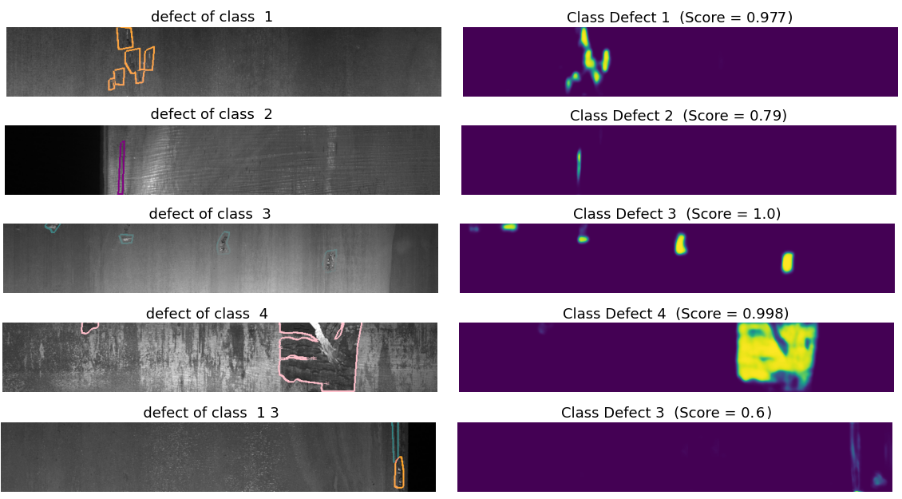
Steel Surface Defect Types (Severstal Dataset)
Severstal Dataset: 12,568 grayscale production-line images.
Defect Classes:
  Class 1 (Patches): Cooling and solidification faults.
  Class 2 (Scratches): Mechanical abrasion marks.
  Class 3 (Pits): Blemishes from impurities.
  Class 4 (Blotches): Irregular handling damage.
Complexity: Images frequently contain multiple defect types at once.
Challenges: Low contrast, variable lighting, and extremely small defect sizes.
LEARN . GROW . EXCEL

Slide 5
Deep Learning for Defect Segmentation
Classification: Determines if a defect exists in the image (defect vs. no defect)
Detection: Locates the general area by drawing bounding boxes around defects.
Segmentation: Generates precise, pixel-level masks revealing the exact location, shape, and size of the defect.
The Framework: We use Convolutional Neural Networks (CNNs) because they excel at learning hierarchical features, from simple edges to complex defect patterns.
LEARN . GROW . EXCEL

Slide 6
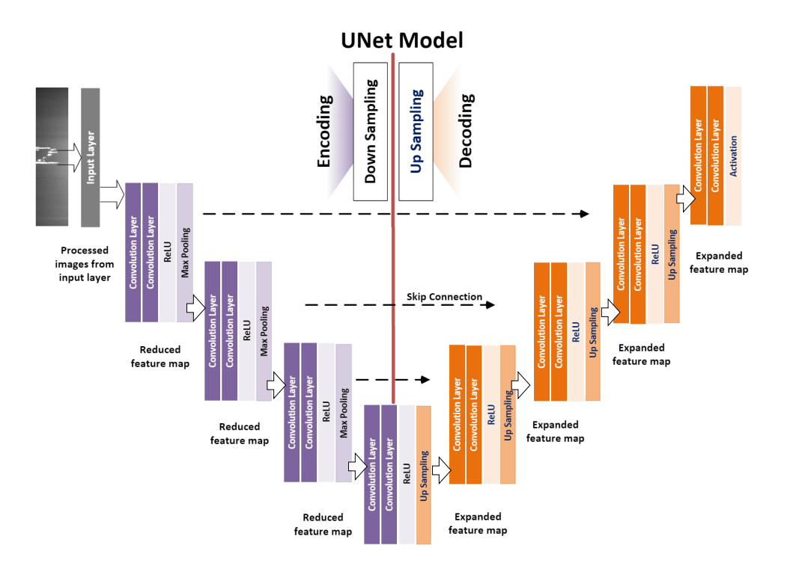
U-Net Architecture
Encoder: Compresses the input image to extract essential features and structural patterns.
Decoder: Up samples the compressed data to reconstruct the spatial dimensions of the original image.
Skip Connections: Direct links that transfer high-resolution spatial details directly from the encoder to the decoder.
Functional Output: The network merges broad structural context with precise spatial data to generate accurate pixel-level defect boundaries.
LEARN . GROW . EXCEL

Slide 7
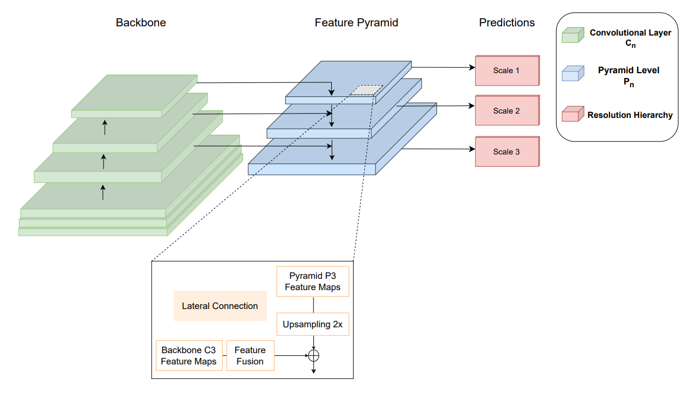
Feature Pyramid Network (FPN) Architecture
Bottom-Up Pathway: Executes a standard feedforward pass through the backbone network to generate feature maps at multiple scales.
Top-Down Pathway: Up samples high-level, semantically strong feature maps to provide higher spatial resolution.
Lateral Connections: Fuse the up sampled maps with feature maps from the bottom-up pathway using element-wise addition.
Resulting Hierarchy: Creates a comprehensive pyramid of features, enabling the model to detect and localize defects across varying sizes and complexities simultaneously.
LEARN . GROW . EXCEL

Slide 8
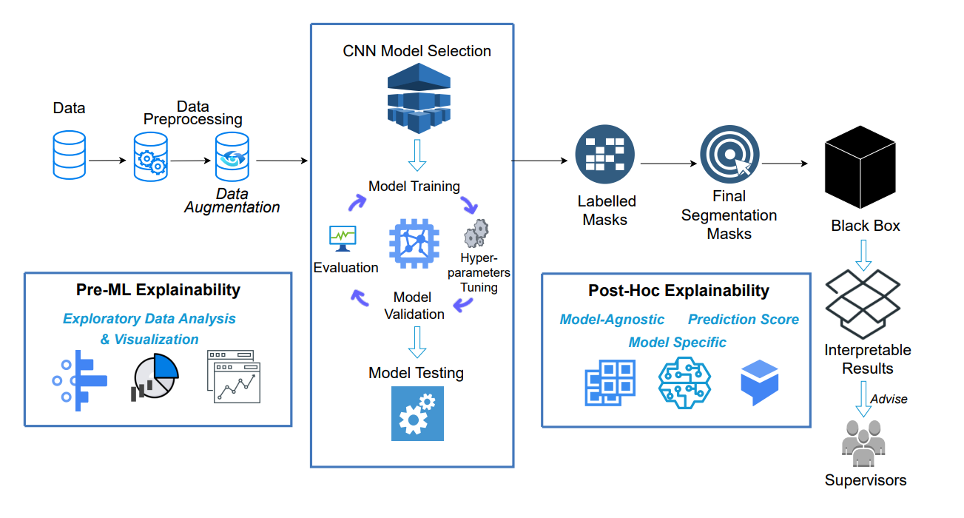
Proposed Framework
Comparative Framework: Evaluates two primary architectures—U-Net and FPN—across three distinct backbone networks: ResNet34, InceptionV3, and EfficientNet-B4.
Systematic Evaluation: Six total model variants were benchmarked under identical processing conditions to determine optimal performance.
Architecture Suitability: U-Net provides high-precision segmentation in low-noise conditions, while FPN demonstrates superior robustness in high-noise industrial settings.
Operational Pipeline: Raw Data → Preprocessing → Data Augmentation → Model Training → Explainable AI (XAI) → Supervisor Decision Support.
LEARN . GROW . EXCEL

Slide 9
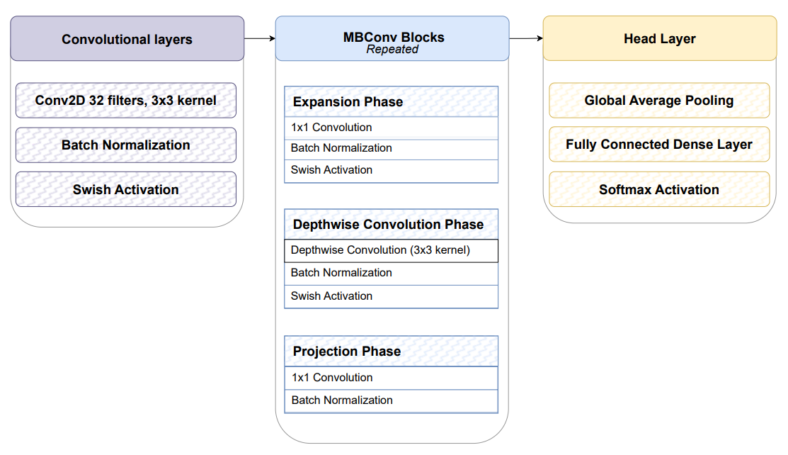
Backbone Network
ResNet34: Utilizes identity shortcut connections to mitigate the vanishing gradient problem, enabling the training of deeper, more effective networks.
InceptionV3: Employs parallel multi-scale convolutions to capture diverse spatial patterns while maintaining computational efficiency.
EfficientNet-B4: Implements a compound scaling method that balances depth, width, and resolution to maximize feature extraction performance.
Architecture Selection: These backbones were chosen to provide a range of learning capacities, allowing for a thorough evaluation of the best approach for segmenting complex steel defects.
LEARN . GROW . EXCEL

Slide 10
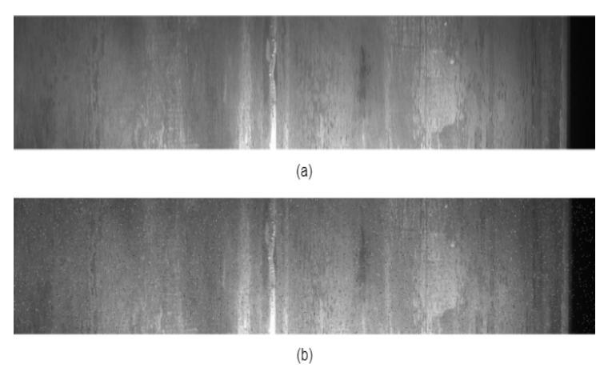


Data Augmentation
Purpose: Increases model robustness by simulating real-world industrial environments.
Geometric Transforms: Applies translation, rotation, and flipping to simulate varying camera angles and sheet positioning.
Noise Injection: Introduces Gaussian and impulse noise to mimic camera sensor degradation, dust, and electrical interference.
Generalization: Forces the model to learn noise-invariant features, ensuring reliability under diverse, non-ideal production conditions.
LEARN . GROW . EXCEL

Slide 11
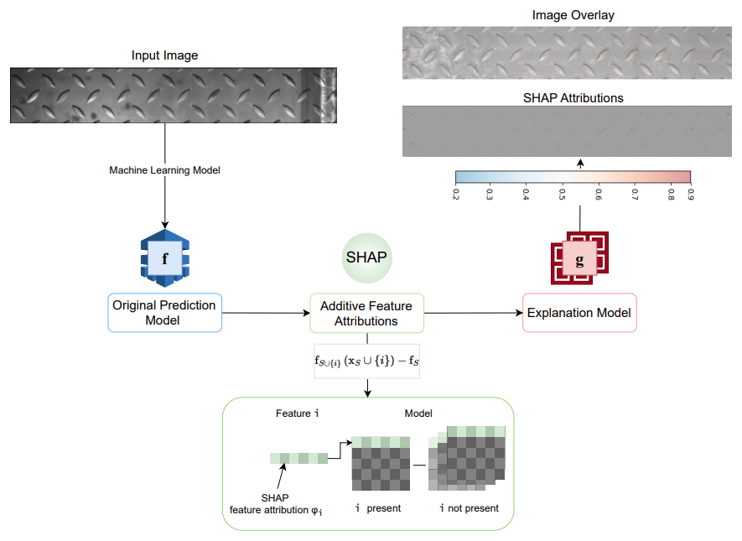
Implementation Strategy
Training Methodology: The model was trained over 30 epochs using an Adam optimizer with a learning rate of 1e-5 and a batch size of 8.
Dataset Partitioning: A 60/20/20 split (Training/Validation/Testing) was implemented to ensure the model could be evaluated independently and effectively.
Hyperparameter Optimization: A hybrid grid and random search strategy was used to identify the configuration that yielded optimal performance.
Evaluation Objective: Models were assessed based on Dice Similarity Coefficient (DSC) and Intersection over Union (IoU) metrics to quantify precise defect delineation.
LEARN . GROW . EXCEL

Slide 12
Performance Results
Baseline Performance: U-Net with an InceptionV3 backbone delivered the highest overall accuracy in clean conditions, achieving a test Dice Score (DSC) of 0.736.
Architecture Comparison: U-Net consistently outperformed the Feature Pyramid Network (FPN) across all tested backbone networks in standard testing.
Backbone Efficiency: The selection of the backbone network proved critical, with ResNet34 consistently providing the least effective segmentation results.
Generalization: Small variance between validation and test metrics confirms that the top-performing models maintain reliable performance on unseen data.
LEARN . GROW . EXCEL

Slide 13
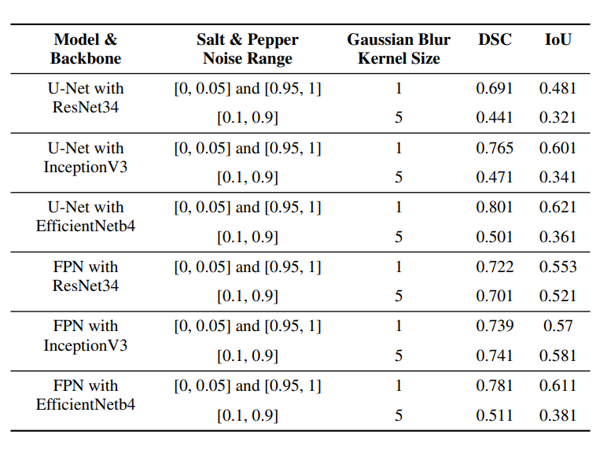
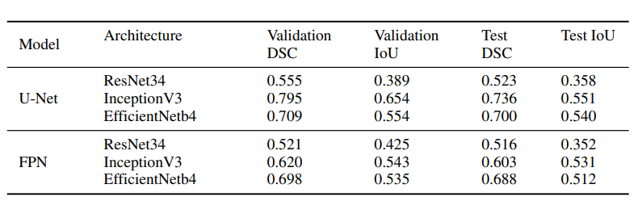
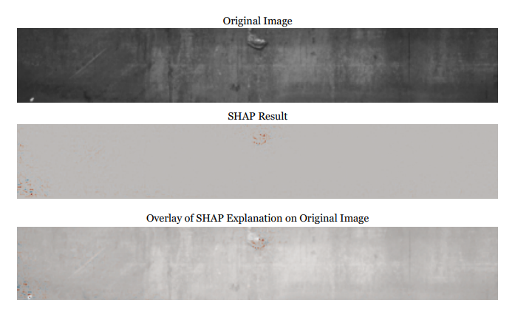
Contd.
LEARN . GROW . EXCEL

Slide 14
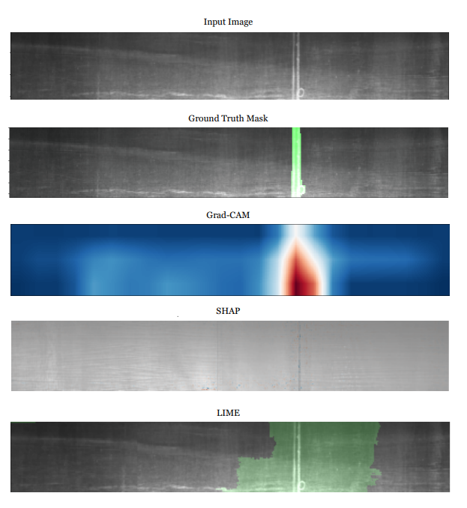
Noise Robustness & XAI Integration
Noise Robustness: While U-Net performs well under clean conditions, FPN architectures maintain superior segmentation accuracy under high-level noise (Gaussian and Salt & Pepper).
Model Stability: The performance gap between FPN and U-Net widens as noise severity increases, validating FPN for real-world, non-ideal industrial settings.
XAI Integration: Explainable AI (GradCAM, SHAP, LIME) is integrated into the pipeline to visualize influential regions and validate defect localization.
Operational Trust: These visualizations provide clear, auditable insights into the model's decision-making process, narrowing the trust gap for industry practitioners.
LEARN . GROW . EXCEL

Slide 15

Advantages
Dual-Architecture Evaluation: Evaluates both U-Net and FPN to identify the optimal framework for varying factory noise conditions.
Realistic Noise Augmentation: Employs advanced low-level and high-level noise injection to accurately replicate true factory lens distortions and sensor failures.
Comprehensive Interpretability: Integrates three distinct XAI methods (GradCAM, SHAP, LIME) to completely eliminate the black-box problem for human operators.
Industrial Scale Validation: Validated on a highly extensive dataset of 12,568 images, proving high generalization compared to smaller sample sizes in literature.

Slide 16
Future Developments
Edge Deployment: Distill, prune, and quantize the models to run efficiently on low-power edge nodes directly on the factory floor.
Expanded Defect Taxonomy: Incorporate additional datasets to train the system on highly rare or complex defect categories using few-shot learning.
Advanced XAI Features: Implement uncertainty quantification and human-in-the-loop validation for automated deployment decisions.
Multi-Modal Inspection: Integrate 3D surface scanning and thermal imaging with visual camera data to capture subsurface anomalies.

Slide 17
Conclusion
System Benchmarking: Successfully evaluated six deep learning configurations across 12,568 industrial manufacturing images to establish an optimized inspection pipeline.
Architectural Trade-offs: Proved that while U-Net architectures deliver high boundary precision in clean conditions, FPN frameworks are necessary for maintaining robustness in noisy industrial environments.
Operational Transparency: Integrated a post-hoc Explainable AI triad (GradCAM, SHAP, and LIME) to successfully eliminate the black-box limitation of deep learning models.
Practitioner Trust: The generated visual explanations provide human operators and supervisors with the interpretability required to confidently adopt automated quality control decisions.

Slide 18
References
[1] Z. Aboulhosn, A. Musamih, K. Salah, R. Jayaraman, M. Omar, and Z. Aung, "Detection of Manufacturing Defects in Steel Using Deep Learning with Explainable Artificial Intelligence," IEEE Access, vol. 11, 2023.
[2] O. Ronneberger, P. Fischer, and T. Brox, "U-Net: Convolutional Networks for Biomedical Image Segmentation," MICCAI, pp. 234-241, 2015.
[3] T.-Y. Lin et al., "Feature Pyramid Networks for Object Detection," CVPR, pp. 2117-2125, 2017.
[4] K. He et al., "Deep Residual Learning for Image Recognition," CVPR, pp. 770-778, 2016.
[5] R. R. Selvaraju et al., "Grad-CAM: Visual Explanations from Deep Networks via Gradient-Based Localization," ICCV, pp. 618-626, 2017.
[6] S. M. Lundberg and S.-I. Lee, "A Unified Approach to Interpreting Model Predictions," NeurIPS, pp. 4765-4774, 2017.

Slide 19
THANK YOU

